Slide 1
HEALTH CARE SENTIMENT ANALYSIS
CAPSTONE PROJECT
Presented By:
YENUGUPALLI SRISANTH
Aditya college of Engineering and Technology
CSE(AIML)

Slide 2
OUTLINE
Problem Statement
Proposed System/Solution
System Development Approach
Algorithm & Deployment
Result
Conclusion
Future Scope
References

Slide 3
PROBLEM STATEMENT
Develop a sentiment analysis model to classify reviews as positive or negative .
Preprocess the review techniques such as lower casing, removing words and lemmatization.
Use the trained model accurately predict the sentiment of new,unseen reviews

Slide 4
PROPOSED SOLUTION
The proposed system aims to address thee problem of sentiment analysis. Sentiment analysis is a natural language processing (NLP) task used to determine the sentiment or emotion expressed in a piece of text. This specific system focuses on classifying text reviews as either positive or negative. The solution will consist of the following components: :
Data Collection:
The system starts with a dataset of text reviews and their corresponding sentiment labels (positive or negative
Data Preprocessing:
The text reviews are cleaned and preprocessed to remove noise and irrelevant information. This includes:
Tokenization: Breaking down text into individual words or tokens.
Stop Words Removal: Removing common words that do not contribute to the sentiment (e.g., "and", "the").
Stemming/Lemmatization: Reducing words to their base or root form (e.g., "running" to "run").
Machine Learning Algorithm:
Implement a machine learning algorithm , such as Naive bayes classifier to predict the review that is positive or negative
Deployment:
Develop a user-friendly interface or application that provides real-time predictions for Reviews
Evaluation:
The model's performance is evaluated using metrics like accuracy and a classification report, which includes precision, recall, and F1-score
Fine-tune the model based on feedback and continuous monitoring of prediction accuracy.
Result

Slide 5
SYSTEM APPROACH
The "System Approach" section outlines the overall strategy and methodology for developing and implementing the rental bike prediction system. Here's a suggested structure for this section:
System requirements:
Operating System: Any modern OS (Windows, macOS, Linux)
Python: Version 3.6 or higher
Jupyter Notebook: Installed through Anaconda distribution or standalone
Library required to build the model :
pandas: For data manipulation and analysis.
scikit-learn:
TfidfVectorizer: For converting text data into numerical features.
train_test_split: For splitting data into training and testing sets.
MultinomialNB: For training the Naive Bayes model.
accuracy_score and classification_report: For evaluating the model.
nltk: For natural language processing tasks, such as tokenization and removing stop word

Slide 6
ALGORITHM & DEPLOYMENT
In the Algorithm section, describe the machine learning algorithm chosen for predicting positive or negative. Here's an example structure for this section:
Algorithm Selection:
The Naive Bayes algorithm is a probabilistic machine learning model that's commonly used for text classification tasks, such as sentiment analysis. It is based on Bayes' Theorem with the assumption of independence among predictors
Data Input:
The primary source of input features is the text data from the reviews.
Training Process:
The Naive Bayes algorithm is a simple yet powerful method used for text classification tasks like sentiment analysis. It works by applying Bayes' Theorem and assumes that the features (words in this case) are independent of each other. Here’s how it works:
Data Collection: Gather labeled text data, such as reviews with sentiments (positive or negative).
Text Preprocessing: Clean the text by converting it to lowercase, removing punctuation and stop words, and tokenizing it into individual words.
Feature Extraction: Use the TF-IDF (Term Frequency-Inverse Document Frequency) method to convert the text into numerical features that represent the importance of each word.
Model Training: Split the data into training and testing sets. Train the Multinomial Naive Bayes model using the training data.
Evaluation: Evaluate the model's performance using metrics like accuracy, precision, recall, and F1-score on the testing data.
This approach is efficient and often yields good results for text classification tasks, making it a popular choice for sentiment analysis.
Prediction Process:
The sentiment analysis in this Jupyter notebook works by comparing features of new reviews to what the model learned from pre-labeled data. After cleaning the new review text, it's converted into numerical features similar to the training data. The model then uses these features to match patterns it learned during training, allowing it to predict the sentiment (positive, negative, or neutral) of the new review. While real-time data isn't directly used for individual predictions, the training data itself might reflect current trends or events, indirectly incorporating a real-time element

Slide 7
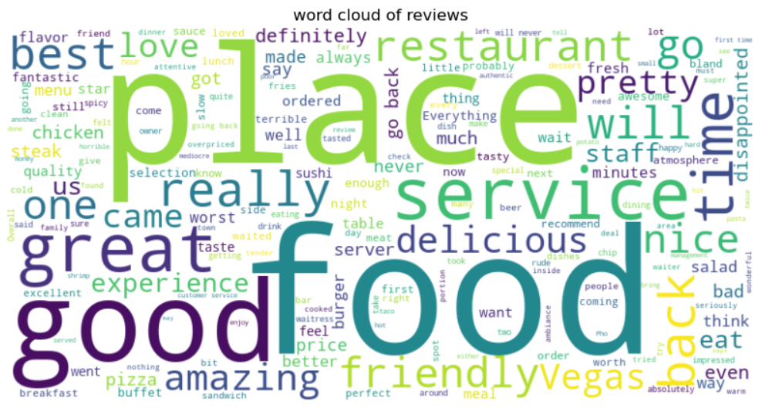
RESULT

Slide 8
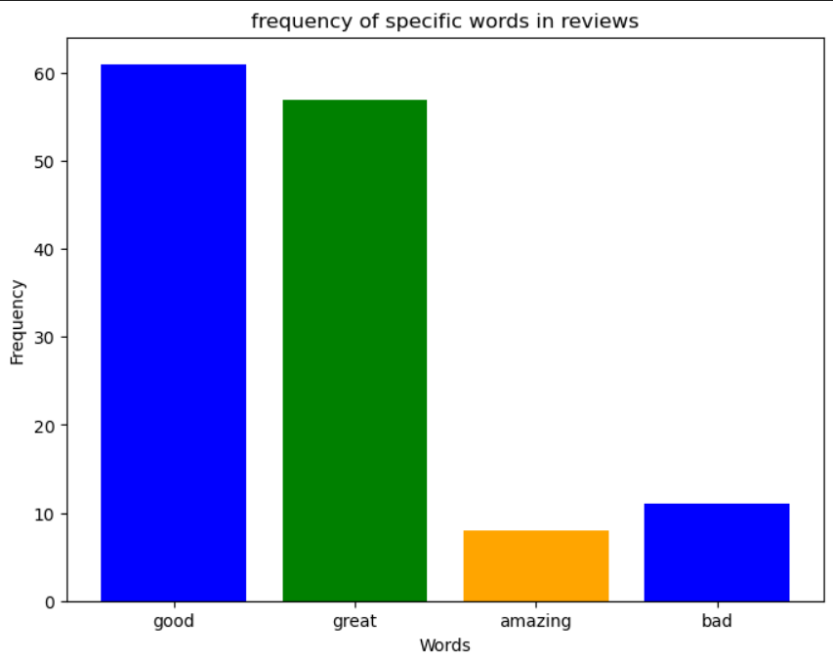
FREQUENCY-BAR CHART

Slide 9
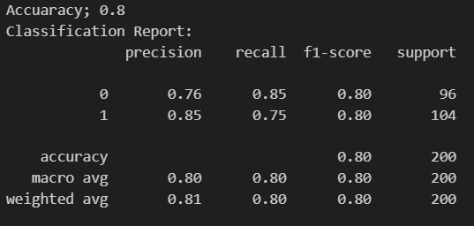
ACCURACY RESULT

Slide 10
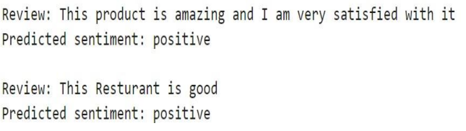
PREDICTIONS

Slide 11
CONCLUSION
A sentiment analysis project using a machine learning model. The model is trained on labelled data to predict the sentiment (positive, negative, neutral) of new reviews. By cleaning and converting new reviews into numerical features, the model can compare them to patterns learned during training, enabling sentiment prediction. While real-time data isn't directly used for individual predictions, the training data itself might reflect current trends for a more nuanced analysis.
To evaluate the effectiveness of this solution, further analysis is needed. Metrics like accuracy, precision, recall, and F1-score can reveal the model's strengths and weaknesses in identifying different sentiments. Challenges like overfitting and neutral sentiment classification can be addressed through techniques like data augmentation, regularization, or incorporating a larger training dataset with more neutral examples. Overall, this project provides a solid foundation for sentiment analysis, and further refinements can enhance its effectiveness

Slide 12
FUTURE SCOPE
This sentiment analysis system is a great start, but there's room to grow! We could include social media buzz or train the system for specific fields like finance. Even handling multiple languages would be cool! To improve accuracy, we can explore fancy tricks to understand how words relate to each other, or even combine multiple models for better results. Thinking outside the box, we could analyze feelings in real time using special computer setups or leverage super-powered learning techniques. By making the system more transparent, people can trust it more and we can keep improving it. There's a lot of potential to make this sentiment analysis system even more powerful.

Slide 13
REFERENCES
This sentiment analysis project is a great foundation, but there's more to explore! Consider using scikit-learn for machine learning techniques or even TensorFlow for advanced deep learning models. Resources on sentiment analysis with product reviews or XAI (Explainable AI) can be helpful. To tackle real-time analysis, edge computing for AI might be interesting. Finally, a bibliography on sentiment analysis research can open doors to even more specific resources. By diving deeper, you can significantly enhance your sentiment analysis system's capabilities

Slide 14
THANK YOU

